Slide 1
NFL Trade Analysis
Chris Haleas
Andrew Eby

Slide 2


Problem
Solution
When it comes to trading NFL players, teams want the best value for their investment. Deciding if a trade is worth it is challenging, as many factors need to be considered: the player's stats, the team's needs, and how the player might perform on a new team. These are high-stakes decisions that can impact both a team's success and their finances. GMs spend countless hours analyzing data to make the best choice. However, not all trades turn out well... some lead to setbacks, while others drive growth!
We aim to provide a reliable prediction of a trade’s value by analyzing a team's strengths and weaknesses at each position and rating players based on key performance features. These ratings are combined to evaluate the trade offers from each team. To further assess the impact of a trade, we compare the player's performance to the potential new team's overall performance.

Slide 3
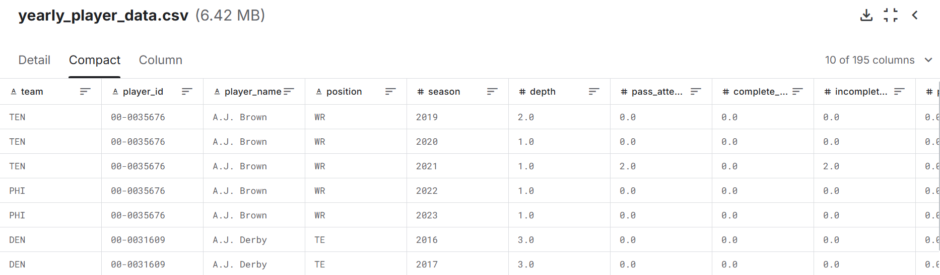
Our Dataset
Our project utilizes a dataset from Kaggle of NFL statistics from the 2012 – 2023 seasons
The dataset contains 195 attributes related to individual player and team statistics
Notes:
Our dataset comes from Kaggle, which holds records of each player’s season stats from 2012 through 2023. contains

Slide 4
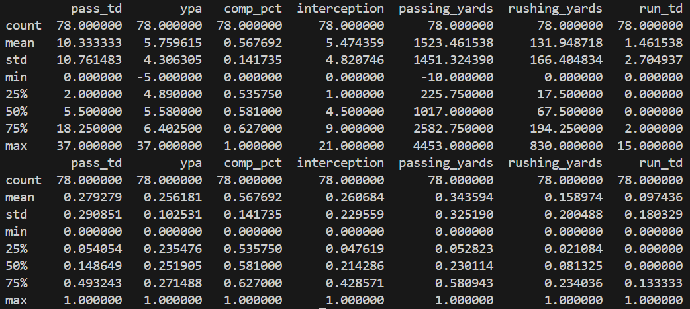
Data Preprocessing
Removing Outliers
We filtered the dataset to exclude players who played fewer than 8 games in a season, as including them led to outliers that could skew the analysis.
Feature Selection
The original dataset contained 195 columns, which we narrowed down to 6-7 key features relevant for evaluating player performance.
Min-Max Scaling
We applied Min-Max scaling to normalize the data, reducing disproportions and ensuring a smooth gradient for better model performance.
Before & After Applying Min-Max Scaling

Slide 5
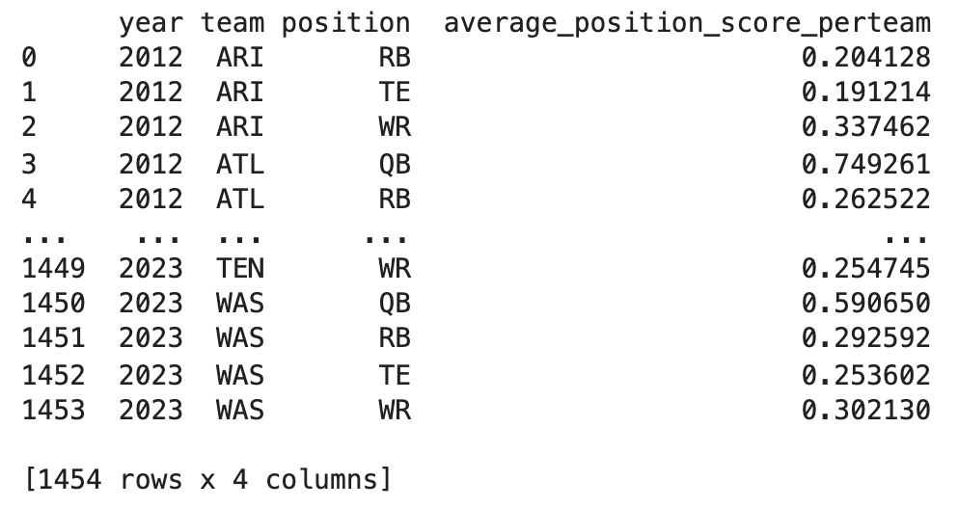
Scoring of Data
We calculated player performance scores by averaging the normalized values of key performance metrics for each position. To evaluate a team's performance per position, we computed the average performance scores of players who participated in at least 8 games during a season.
Key Performance Metrics...
Quarterback (QB) Features: Touchdown Pass Percentage, Yards Per Attempt, Completion Percentage, Passing Yards Per Game, Passing Yards, Passing Air Yards
Running Back (RB) Features: Rushing Touchdown Percentage, Yards Per Carry, Yards Per Touch, Rushing Yards Per Game, Rushing Yards, Receptions
Wide Receiver (WR) Features: Receiving Touchdown Percentage, Yards Per Reception, Target Share, Air Yards Share, Targets, Receptions, Receiving Yards
Tight End (TE) Features: Receiving Touchdown Percentage, Yards Per Reception, Target Share, Air Yards Share, Targets, Receptions, Receiving Yards
Position Performance Scores...

Slide 6
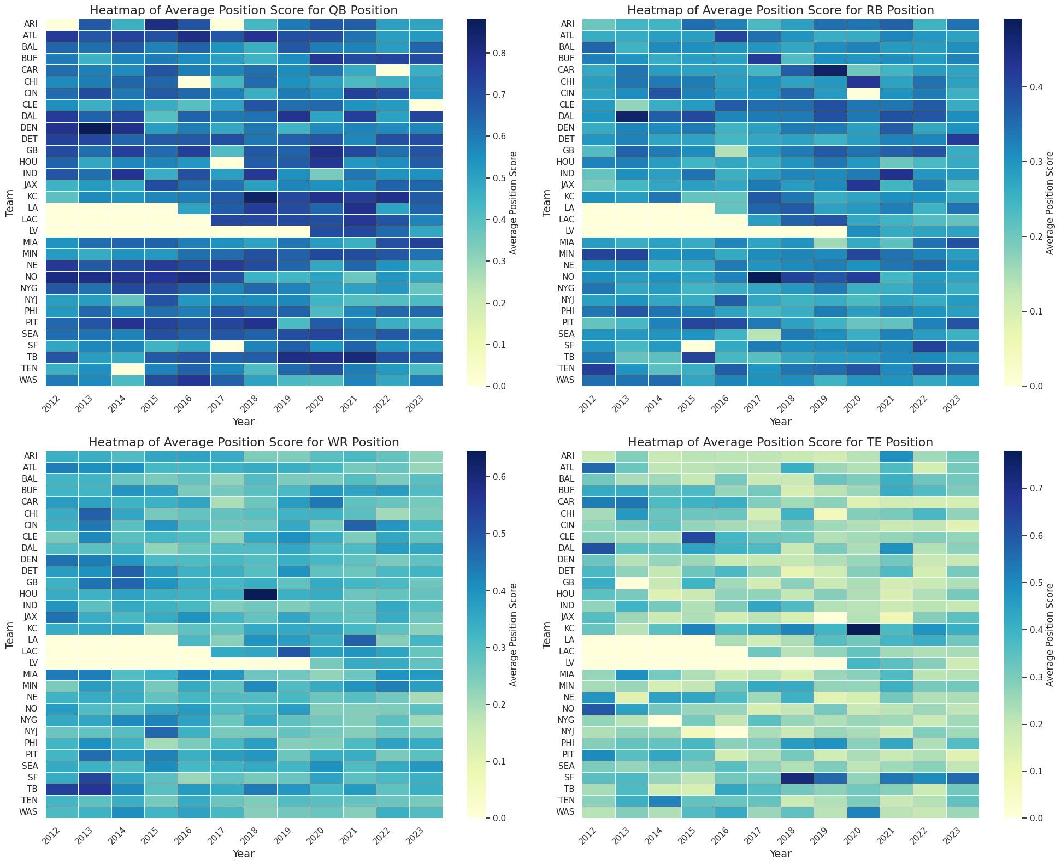
Visualization
Each heatmap represents a position, displaying position performance scores by year for each team.
Teams with higher average performance scores at a position are shown with darker colors, indicating less need for players in that position.
Lighter colors represent lower scores, signaling a greater need for players in that role.
Notes:
Darker colors indicate a good player already at that position, while lighter colors indicate a lack of skill at the position

Slide 7
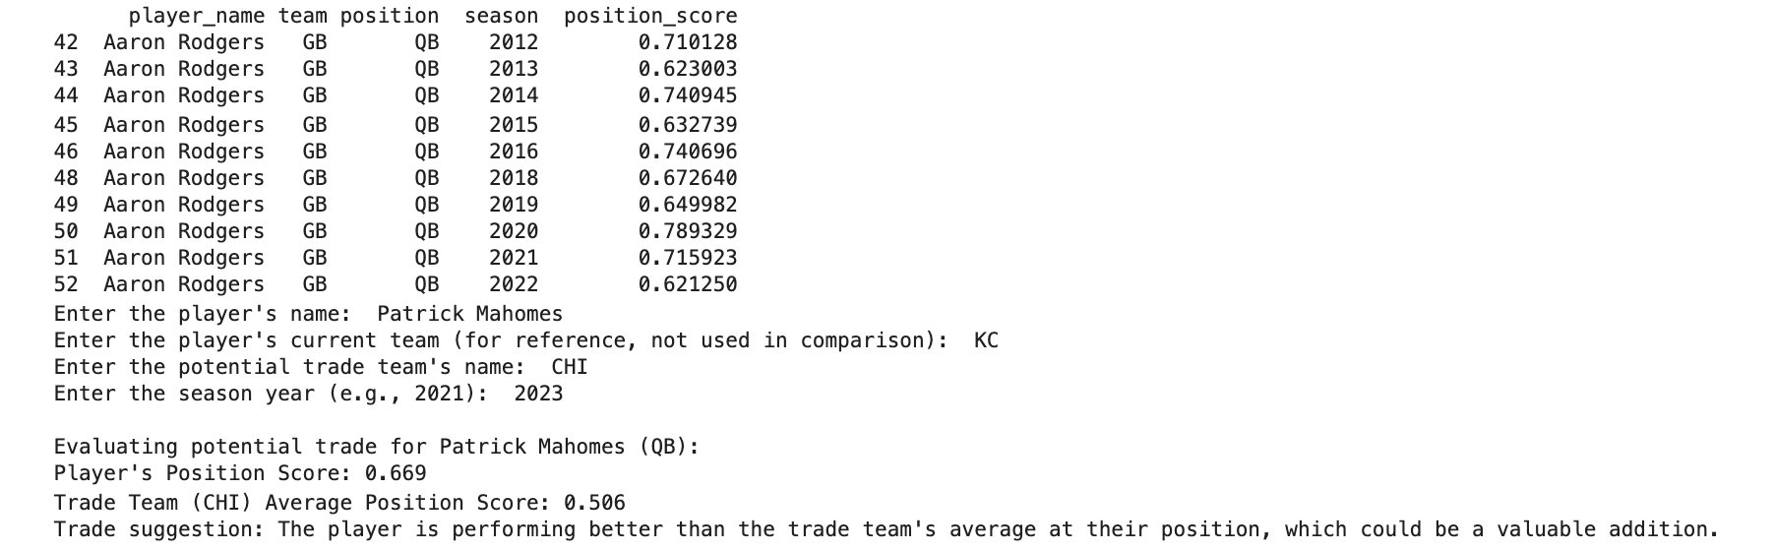
Data Application
Based on the trade team's performance and what they are lacking, the system compares the player's position score with the team's average position score. If the player is performing better than the team's average at their position, it suggests that the player could be a valuable addition. If the player’s performance is below the team's average, it indicates that the trade may not improve the team’s current standing.
Example:​

Slide 8
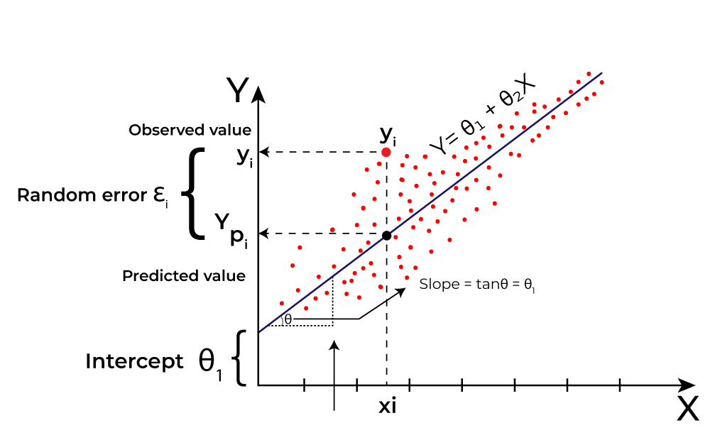
Moving Forward
Enhanced Trade Evaluation: We plan to strengthen our grading of a trade by using linear regression to predict how a player will perform on a future team. By analyzing the player's historical performance data and the team's current needs, we can evaluate the potential impact of the player’s addition on the team's overall performance.
Source: https://www.geeksforgeeks.org/ml-linear-regression/
Notes:
By using linear regression, we’re able to simulate a season to see how a player would perform on a future team. This is done by looking at the impact they have on team stats between seasons

Slide 9
Thank You!

